Slide 1
Why Rmarkdown sparks joy
Leigh Alexander
IWD Women Techmakers Lightning Talks 2019

Slide 2






Who am I?
Leigh Alexander
@exuberantleigh
Bioinformatics Scientist @
*
Proteomics
Predictive Modeling/
Machine Learning
* Our lawyer says to say I’m not “officially” representing SomaLogic here today. So that.

Slide 3

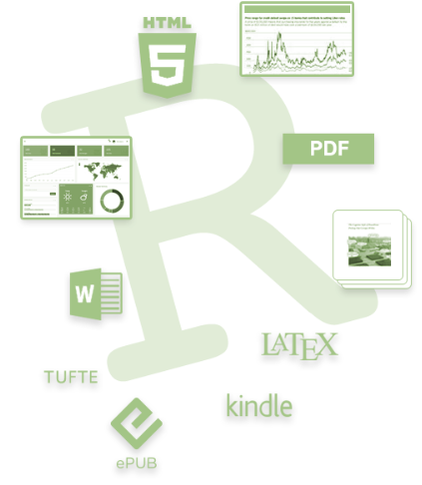
Why RMarkdown brings me joy
What is RMarkdown?
Analysis notebook
AND
Communication tool

Slide 4
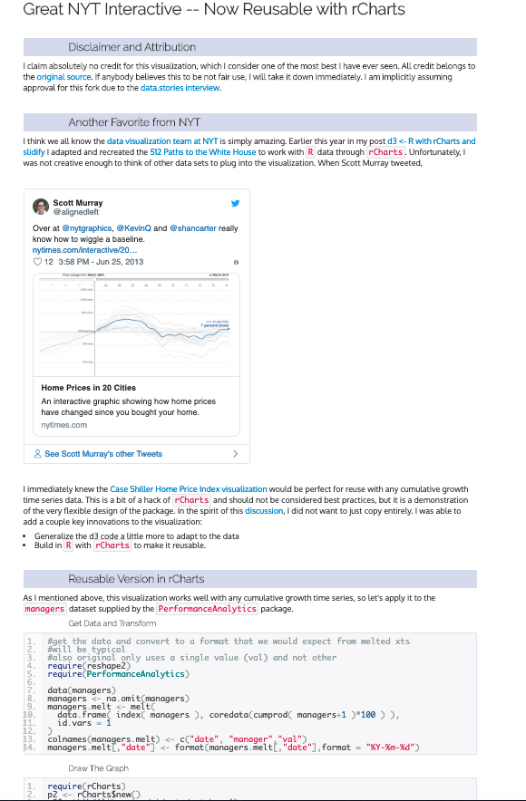
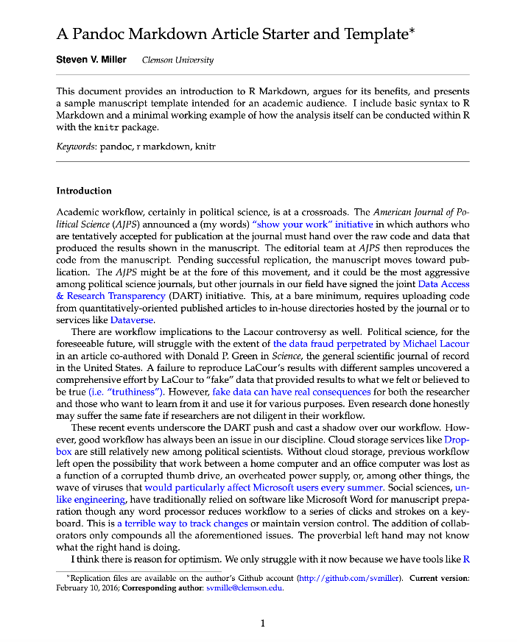
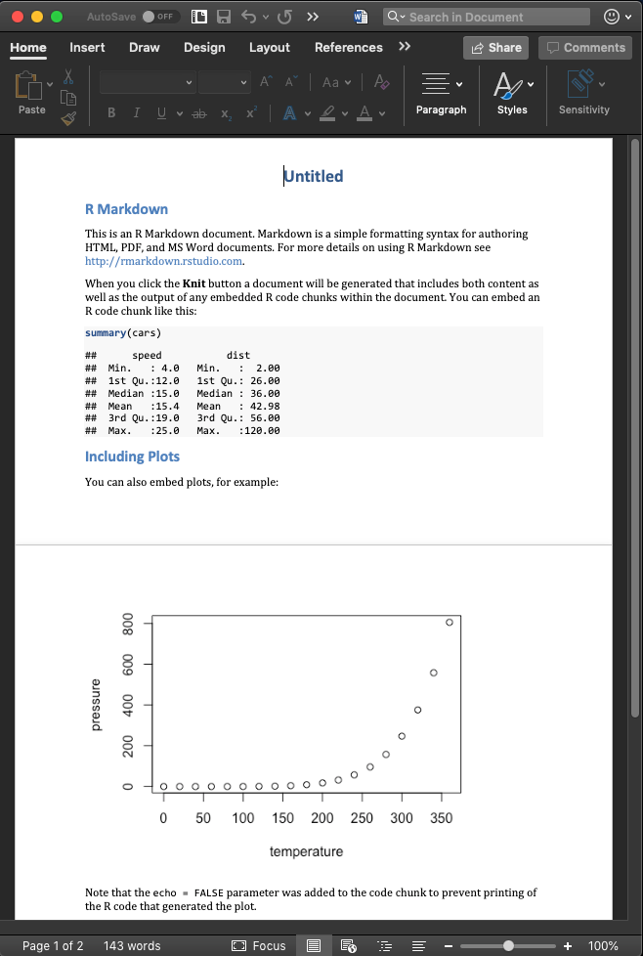
HTML & PDF & Word

Slide 5
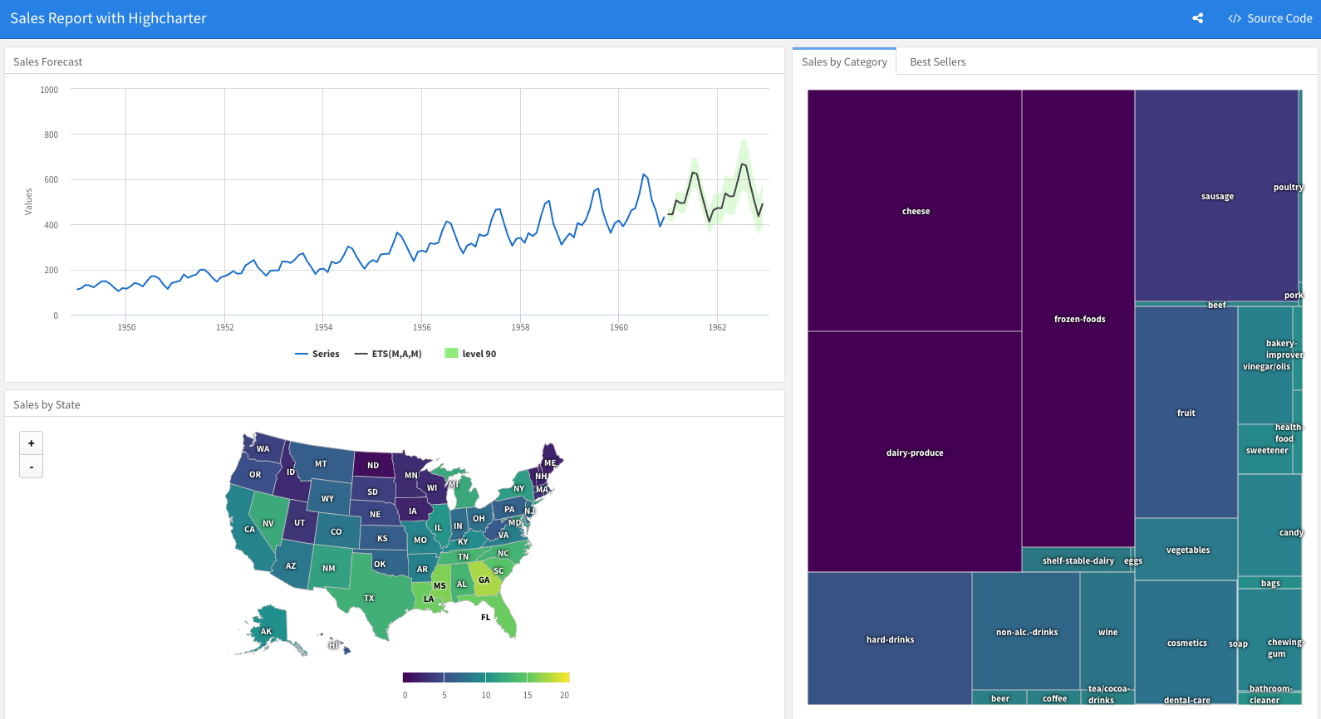
Dashboards

Slide 6
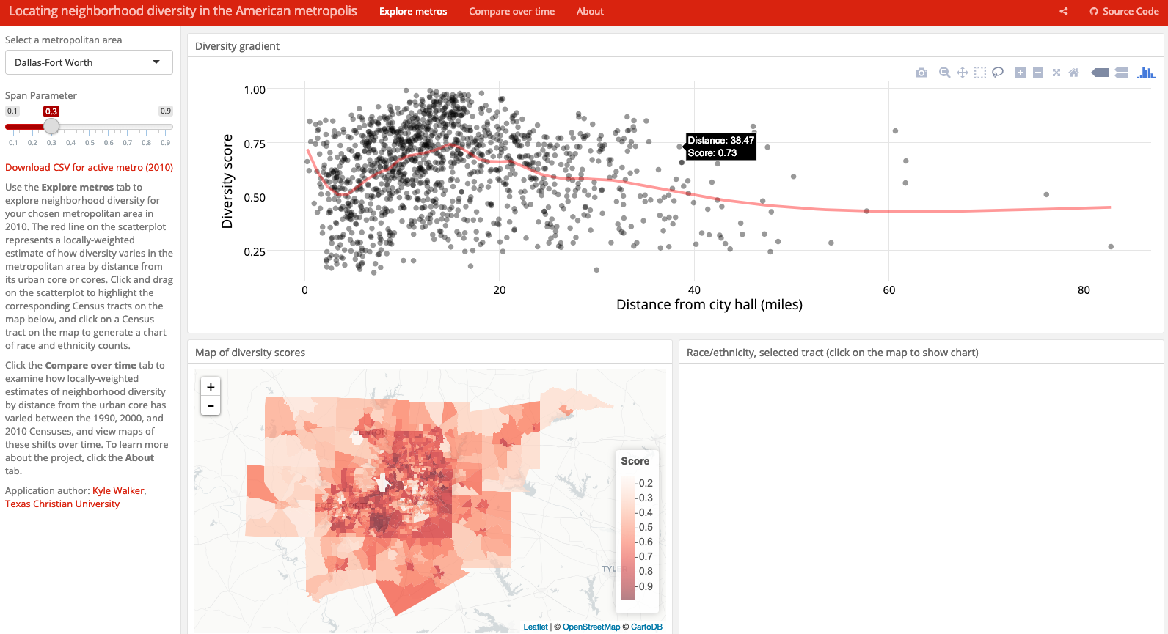
Another Dashboard

Slide 7
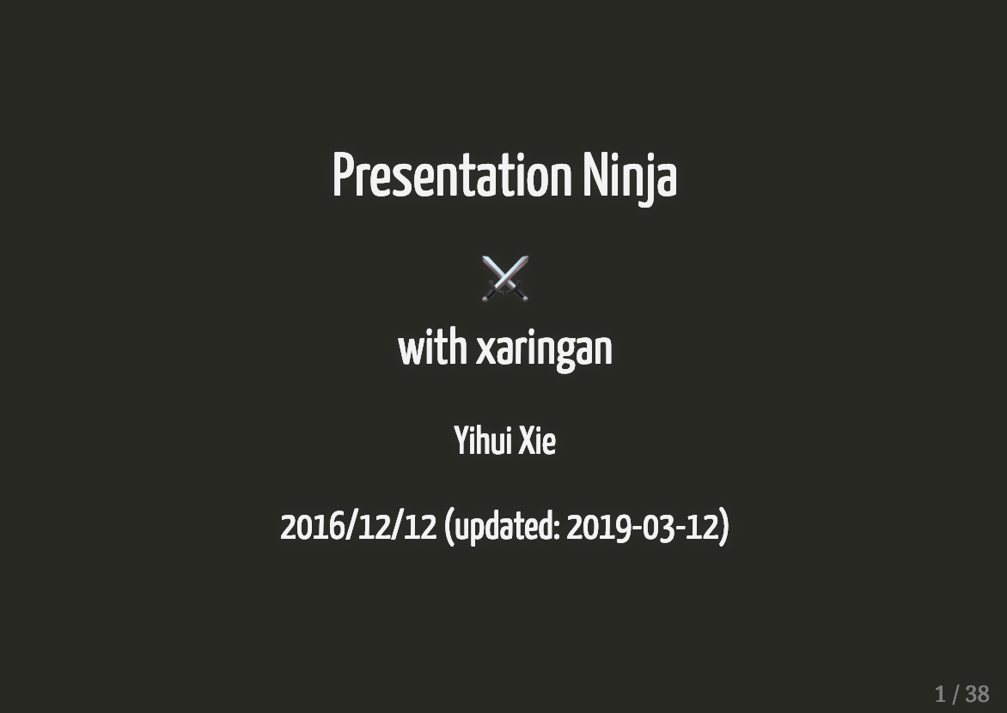
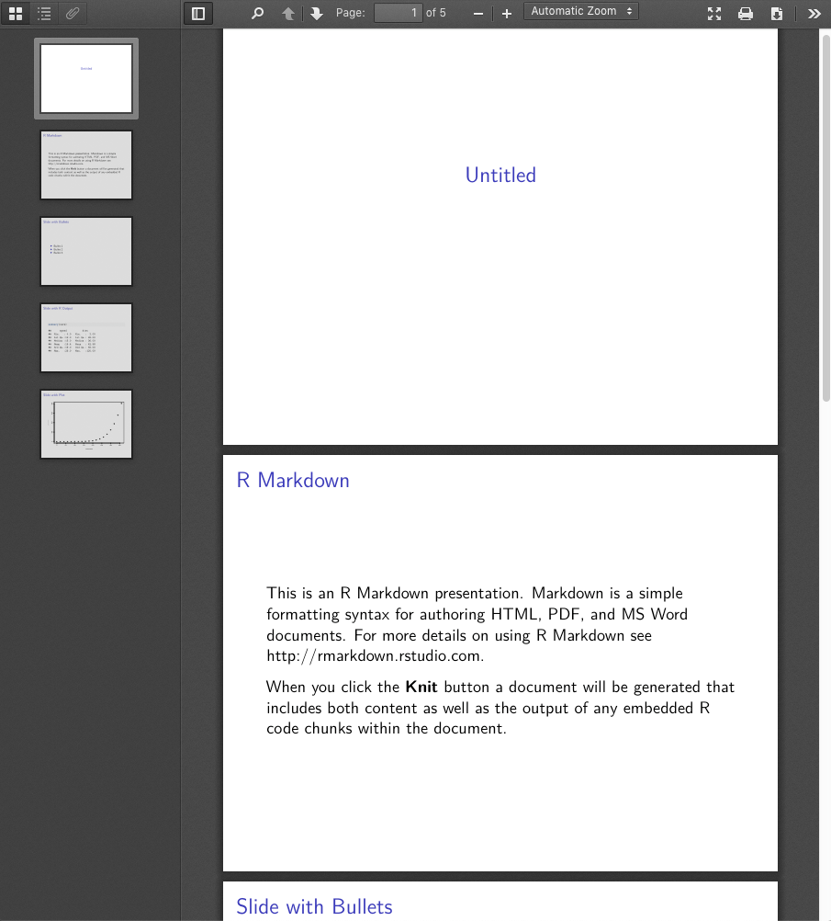
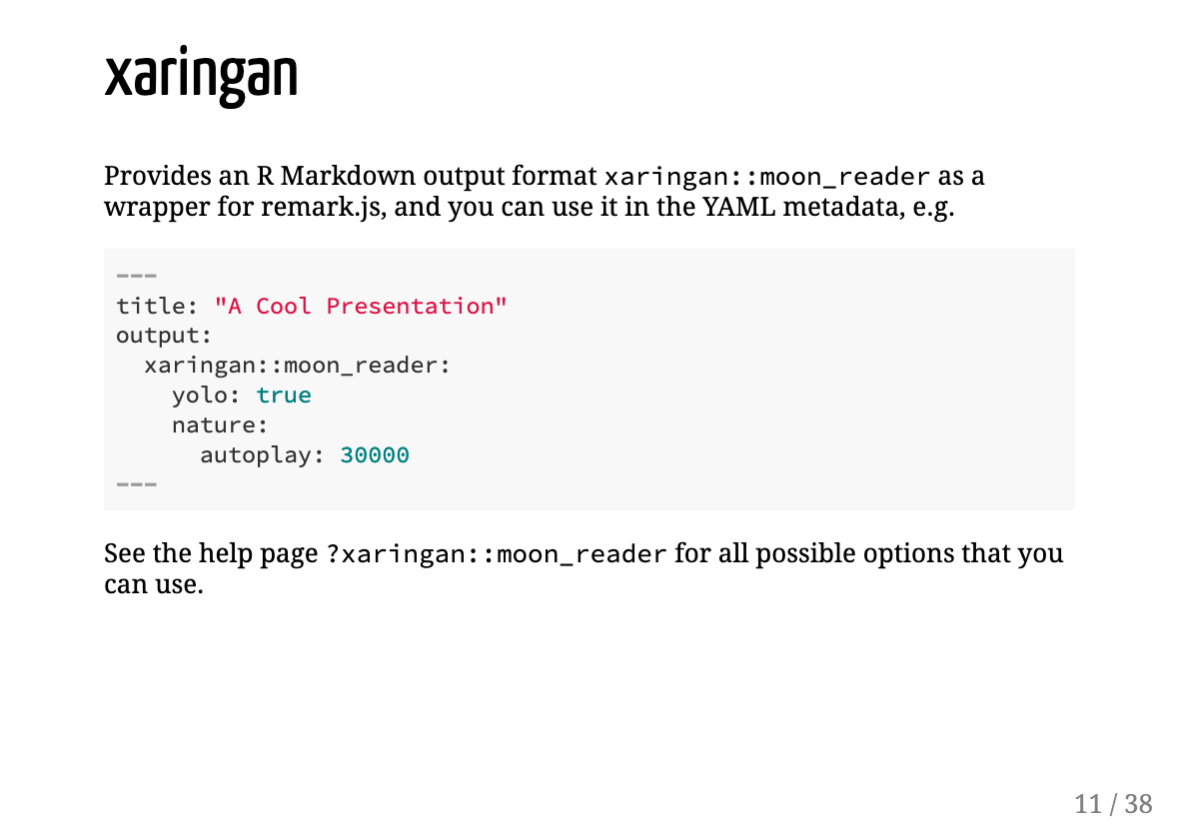
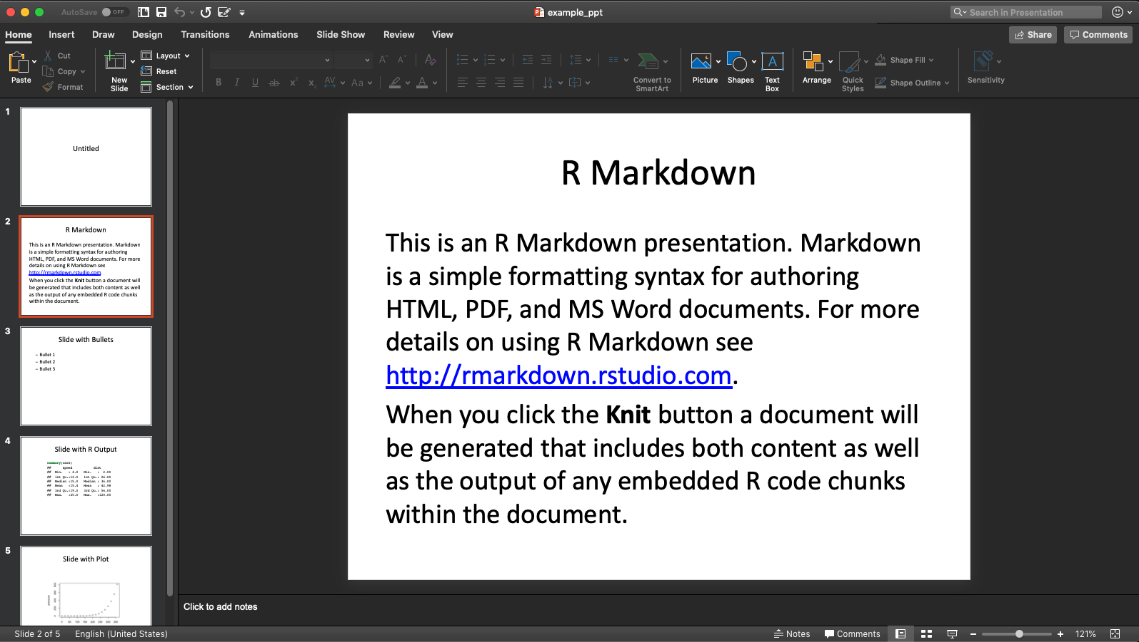
Slides

Slide 8
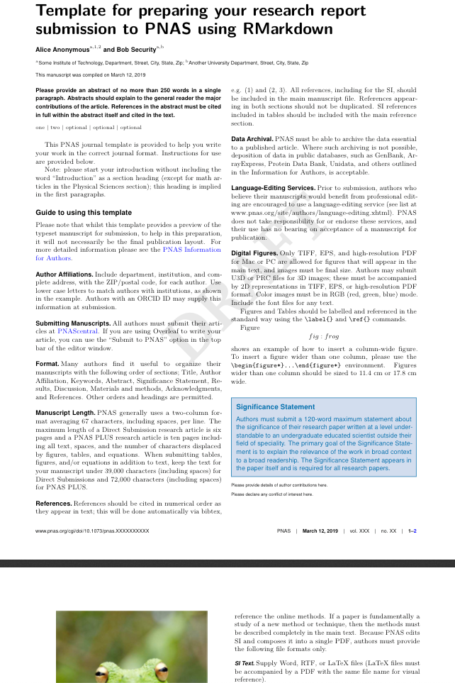
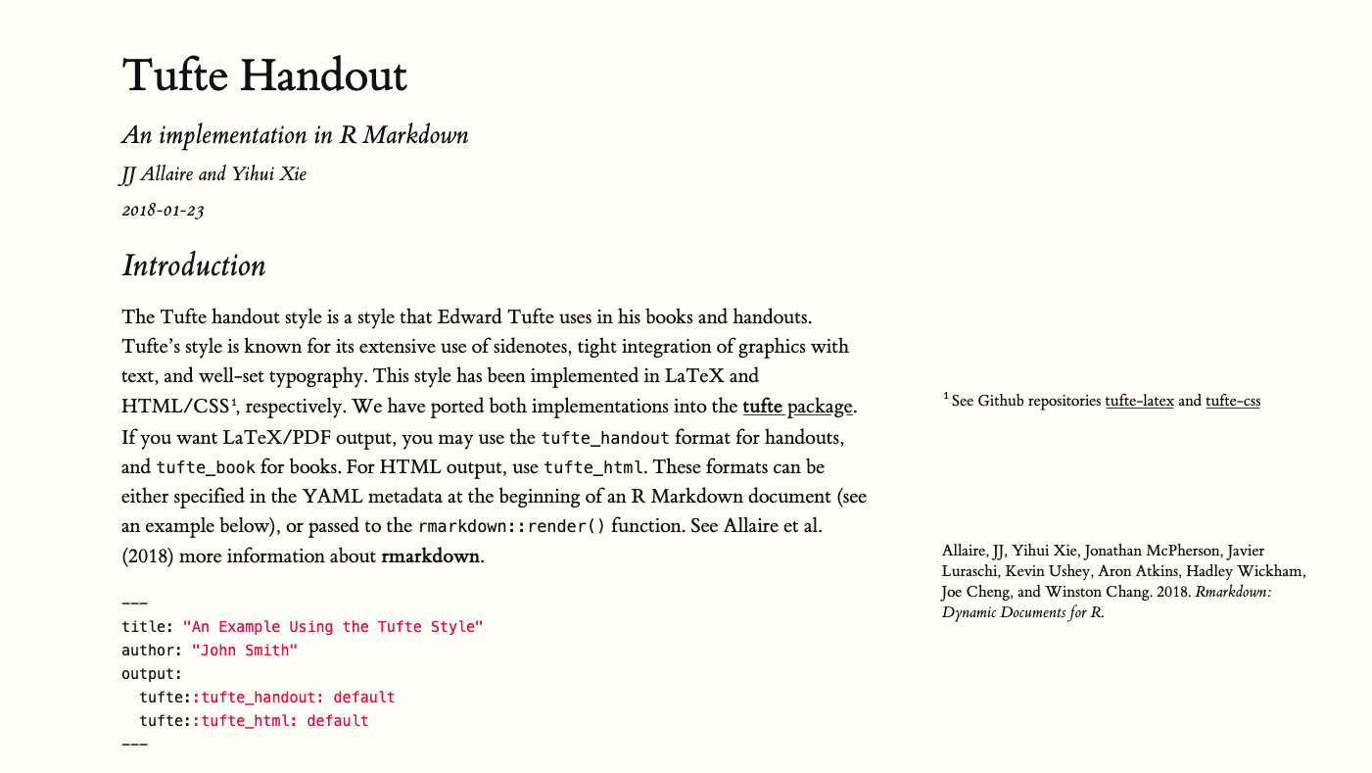
Specialized Formats

Slide 9
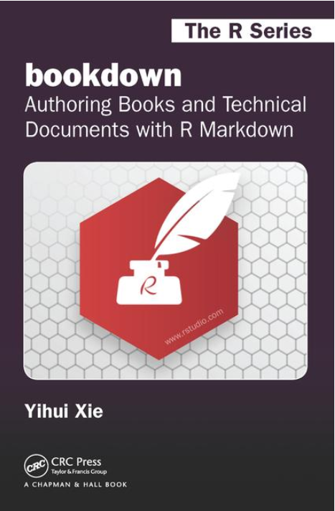
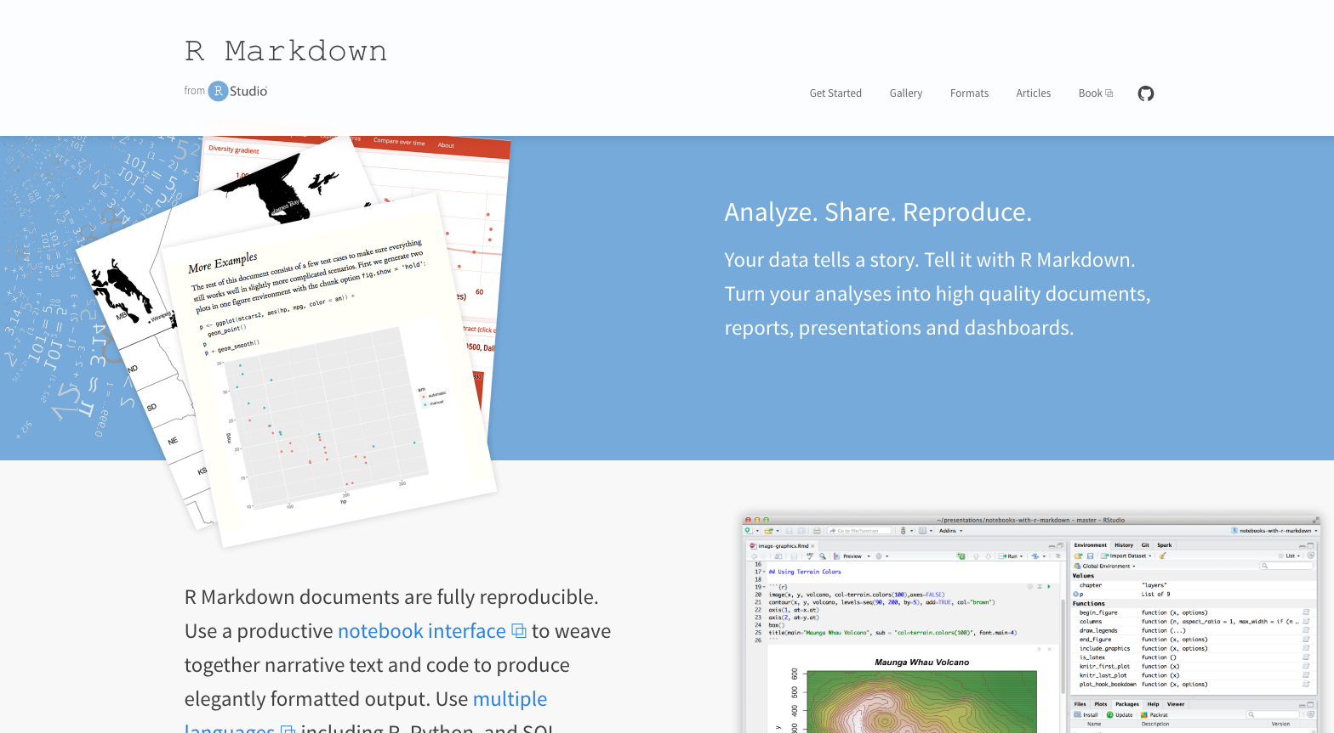
Books & Websites

Slide 10
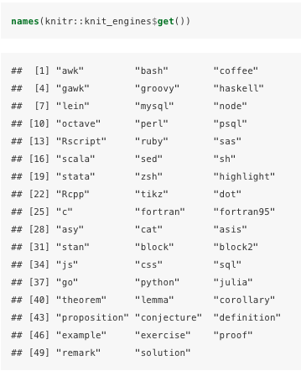
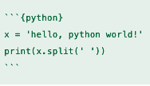
Why RMarkdown brings me joy
Organization & reproducibility of analysis workflows & reports
Straightforward syntax for newbies
Supports use of multiple languages

Slide 11
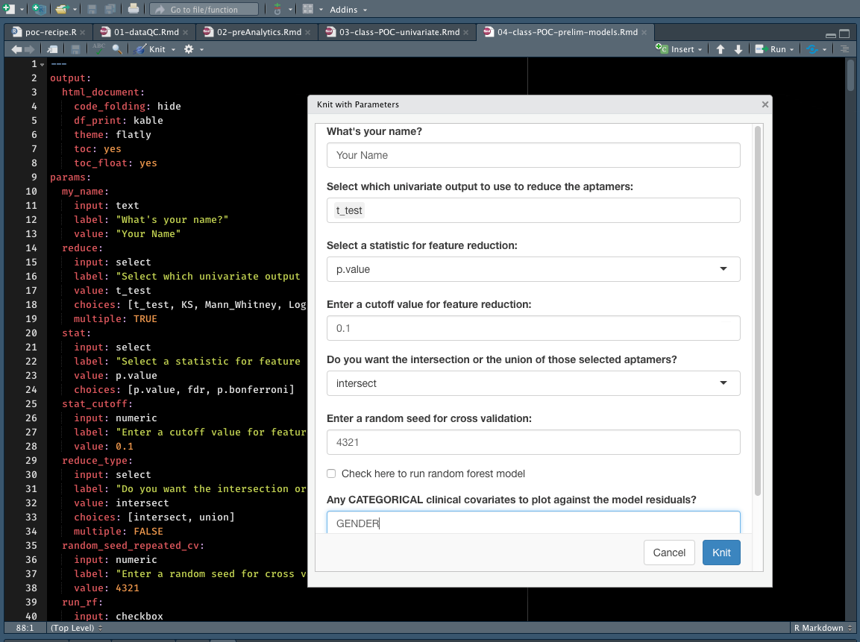
Why RMarkdown brings me joy
Parameterized reports
parameter = user-input variable
“Semi-automate”
Make incremental changes to workflow/report
Notes:
Change to shiny screen shot, incremental changes, change some variables, but dojn’t have to change all the underlying code, beyond just a function but for a entire workflow and resulting report.

Slide 12

Thanks!
Leigh Alexander
@exuberantleigh
lalexander.7@gmail.com
(Me, actively experiencing joy)

Slide 14
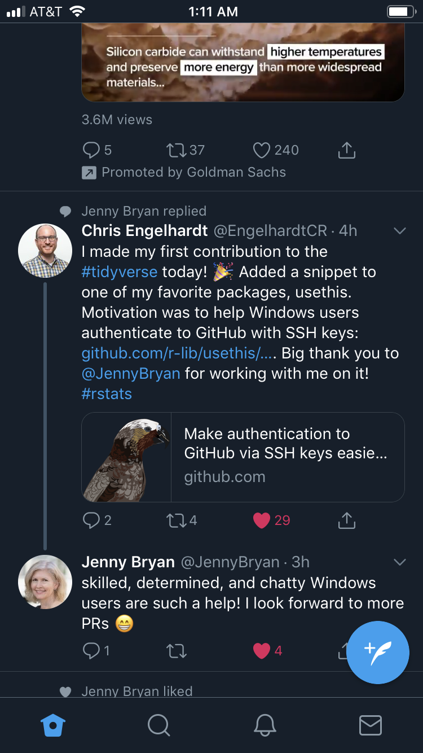

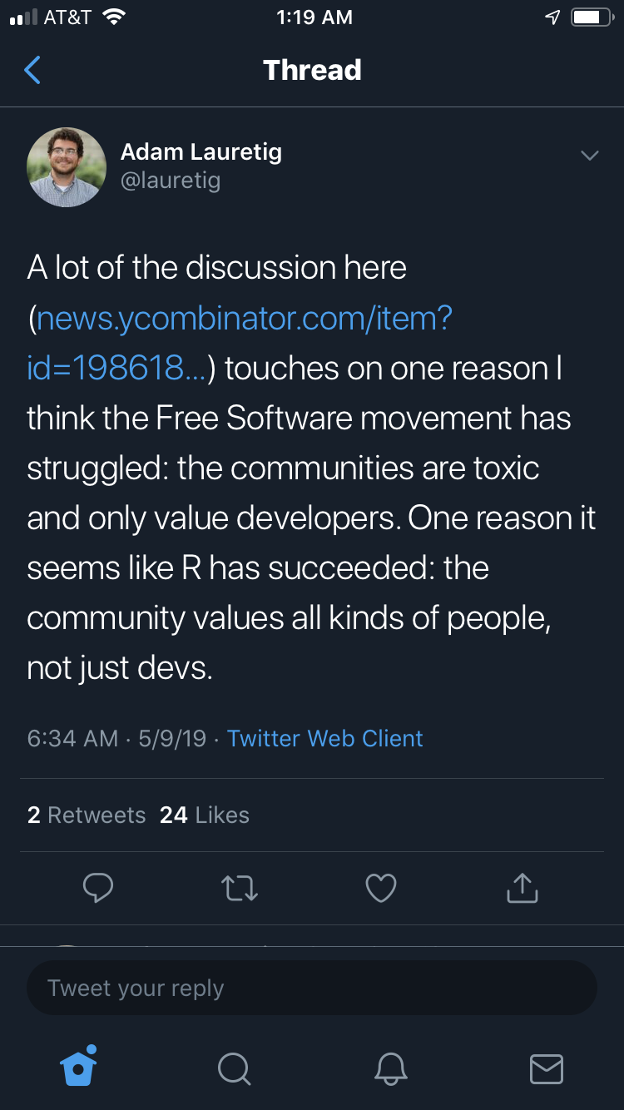
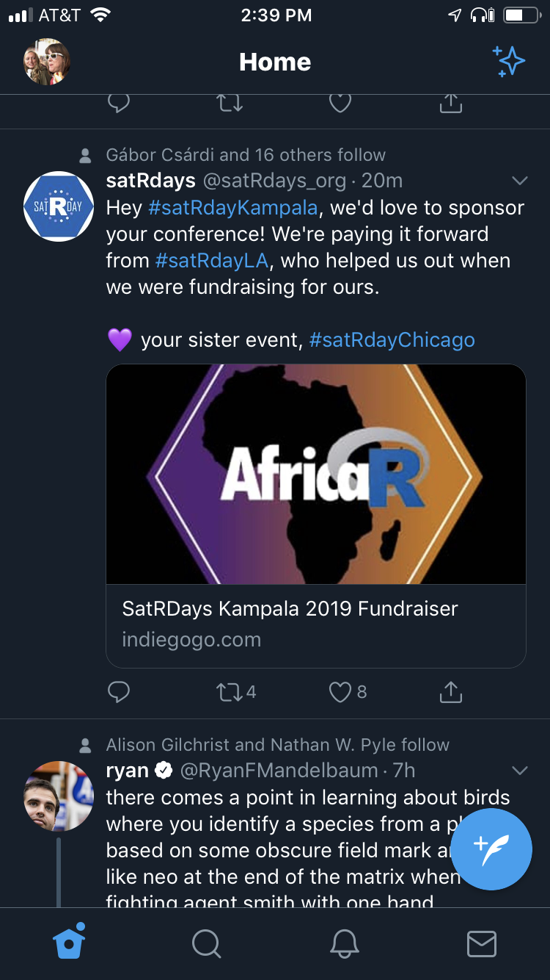
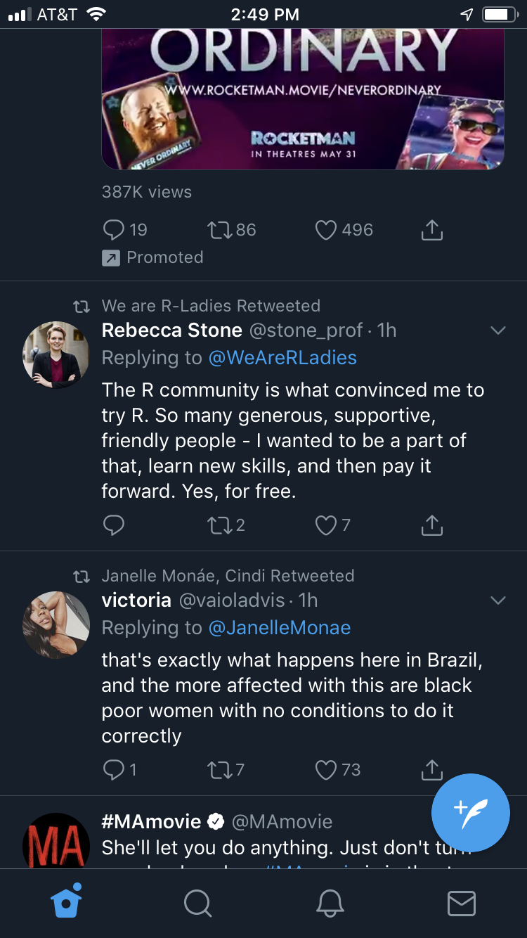


#DumpDataCamp

